Slide 1
SVM

Slide 2
Support Vector Machine
SVMs are supervised learning models with associated learning algorithms that analyze data used for classification and regression analysis
It is mostly used in classification problems.
In this algorithm, each data item is plotted as a point in n-dimensional space (where n is number of features), with the value of each feature being the value of a particular coordinate.
Then, classification is performed by finding the hyper-plane that best differentiates the two classes.
Notes:
Hyperplanes are decision boundaries that help classify the data points. Data points falling on either side of the hyperplane can be attributed to different classes. Also, the dimension of the hyperplane depends upon the number of features. If the number of input features is 2, then the hyperplane is just a line.

Slide 3
The goal of a SVM is to create a flat boundary called a hyperplane, which divides the space to create fairly homogeneous partitions on either side.
In this way, the SVM learning combines aspects of both the instance-based nearest neighbor learning and the linear regression modeling.
Notes:
SVM chooses the extreme points/vectors that help in creating the hyperplane. These extreme cases are called as support vectors, and hence algorithm is termed as Support Vector Machine.

Slide 4
Notable applications include:
Classification of microarray gene expression data in the field of bioinformatics to identify cancer or other genetic diseases
Text categorization such as identification of the language used in a document or the classification of documents by subject matter.
The detection of rare yet important events like combustion engine failure, security breaches, or earthquakes
Notes:
The goal of the SVM algorithm is to create the best line or decision boundary that can segregate n-dimensional space into classes so that we can easily put the new data point in the correct category in the future. This best decision boundary is called a hyperplane.
Types of SVM
SVM can be of two types:
Linear SVM: Linear SVM is used for linearly separable data, which means if a dataset can be classified into two classes by using a single straight line, then such data is termed as linearly separable data, and classifier is used called as Linear SVM classifier.
Non-linear SVM: Non-Linear SVM is used for non-linearly separated data, which means if a dataset cannot be classified by using a straight line, then such data is termed as non-linear data and classifier used is called as Non-linear SVM classifier.

Slide 5
How SVM works
Given labeled training data (supervised learning), the algorithm outputs an optimal hyperplane which categorizes new examples. Consider the following scenarios:
Scenario 1:
In this scenario there are three hyper planes called A,B,C. Now the problem is to identify the right hyper-plane which best differentiates the stars and the circles.

Slide 6
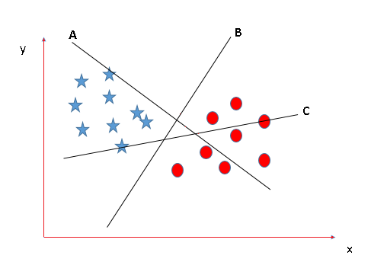

Slide 7
The thumb rule to be known, before finding the right hyper plane, to classify star and circle is that the hyper plane should be selected which segregate two classes better. In this case B classify star and circle better, hence it is right hyper plane.
Scenario 2:
Now take another Scenario where all three planes are segregating classes well. Now the question arises how to identify the right plane in this situation.

Slide 8
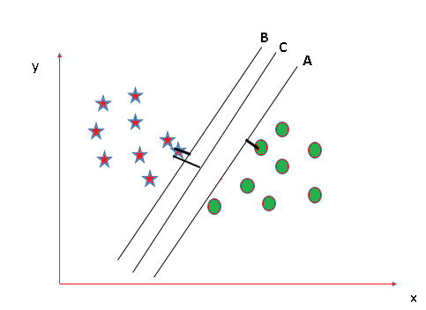

Slide 9
In such scenarios, calculate the margin which is the distance between nearest data point and hyper-plane.
The plane having the maximum distance will be considered as the right hyper plane to classify the classes better.
Here C is having the maximum margin and hence it will be considered as right hyper plane.

Slide 10
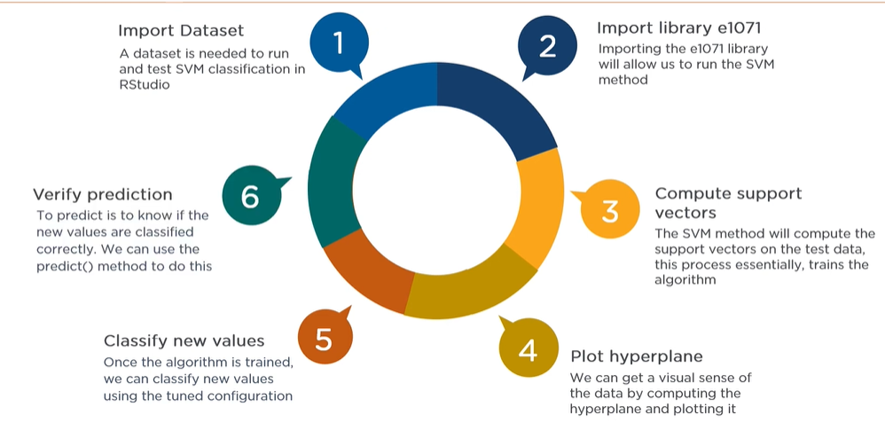

Slide 11
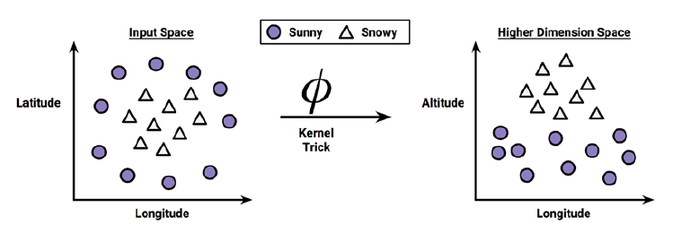
Using kernels for non-linear spaces
In many real-world applications, the relationships between variables are nonlinear.
A key feature of SVMs is their ability to map the problem into a higher dimension space using a process known as the kernel trick. In doing so, a nonlinear relationship may suddenly appear to be quite linear.

Slide 12



The linear kernel does not transform the data at all. Therefore, it can be expressed
simply as the dot product of the features:
The polynomial kernel of degree d adds a simple nonlinear transformation of
the data:
The sigmoid kernel results in a SVM model somewhat analogous to a neural
network using a sigmoid activation function. The Greek letters kappa and delta
are used as kernel parameters:

Slide 13
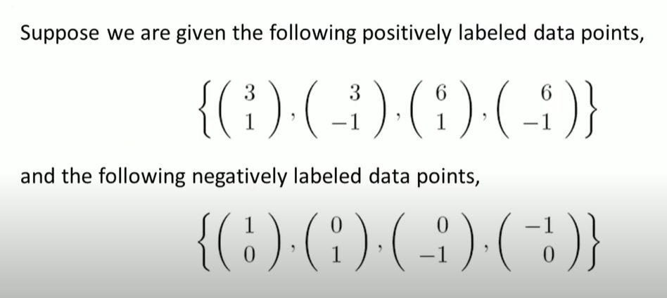
Example

Slide 14
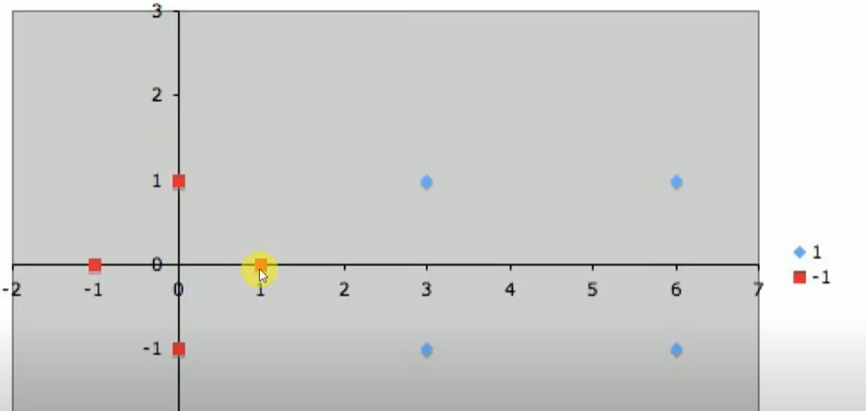

Slide 15
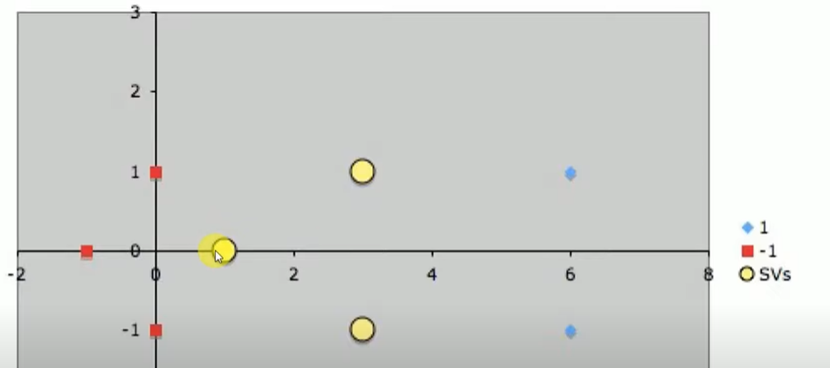

Slide 16
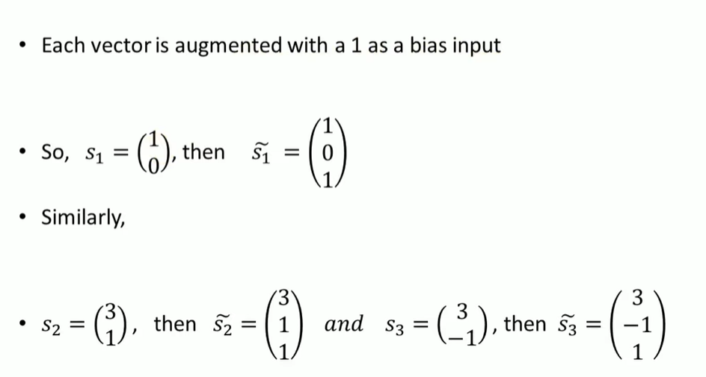

Slide 17
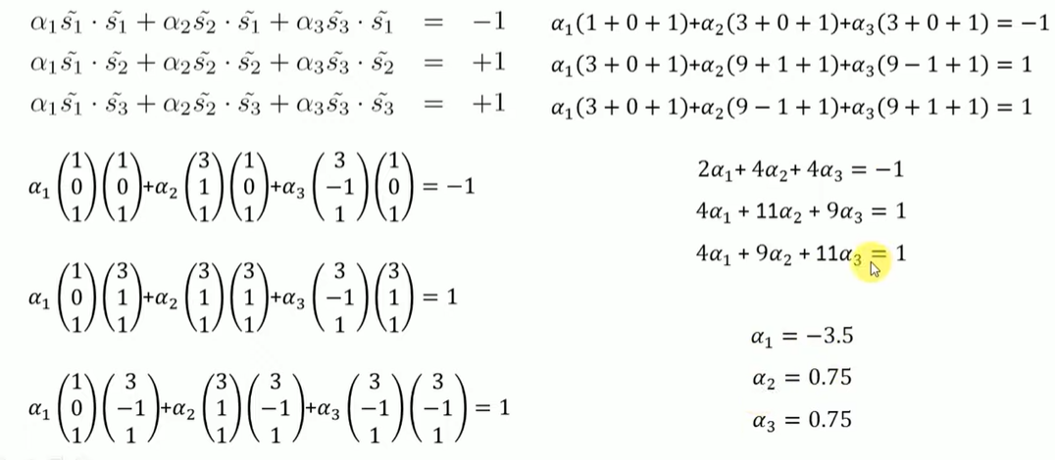

Slide 18
